Slide 1
E-OPD for E-Clinics run by Community Paramedics
Notes:
Introduce the concept of E-OPD for E-Clinics run by community paramedics, including the benefits and challenges of implementing this system.

Slide 2

Community Paramedics
Providing Healthcare Services in Remote Areas
Community paramedics are trained to provide healthcare services in remote areas
They play a critical role in improving access to healthcare for underserved populations
Community paramedics work closely with other healthcare professionals to provide comprehensive care
‎
‎Photo by Unsplash
Notes:
Describe the role of community paramedics in providing healthcare services and the importance of their work in remote areas.

Slide 3
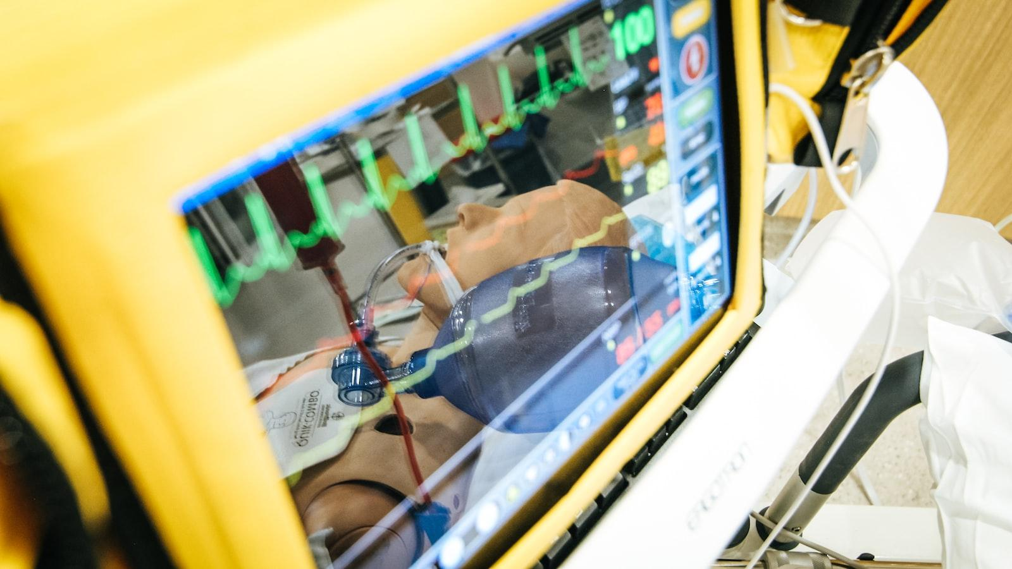
E-Clinics
Providing Healthcare Services Remotely
E-Clinics are a type of telemedicine that provide healthcare services remotely
They can be used to provide a wide range of healthcare services, including consultations, appointments, and prescriptions
E-Clinics are particularly useful for patients who live in remote areas or have mobility issues
‎
‎Photo by Unsplash
Notes:
Explain the concept of E-Clinics and how they can be used to provide healthcare services remotely.

Slide 4
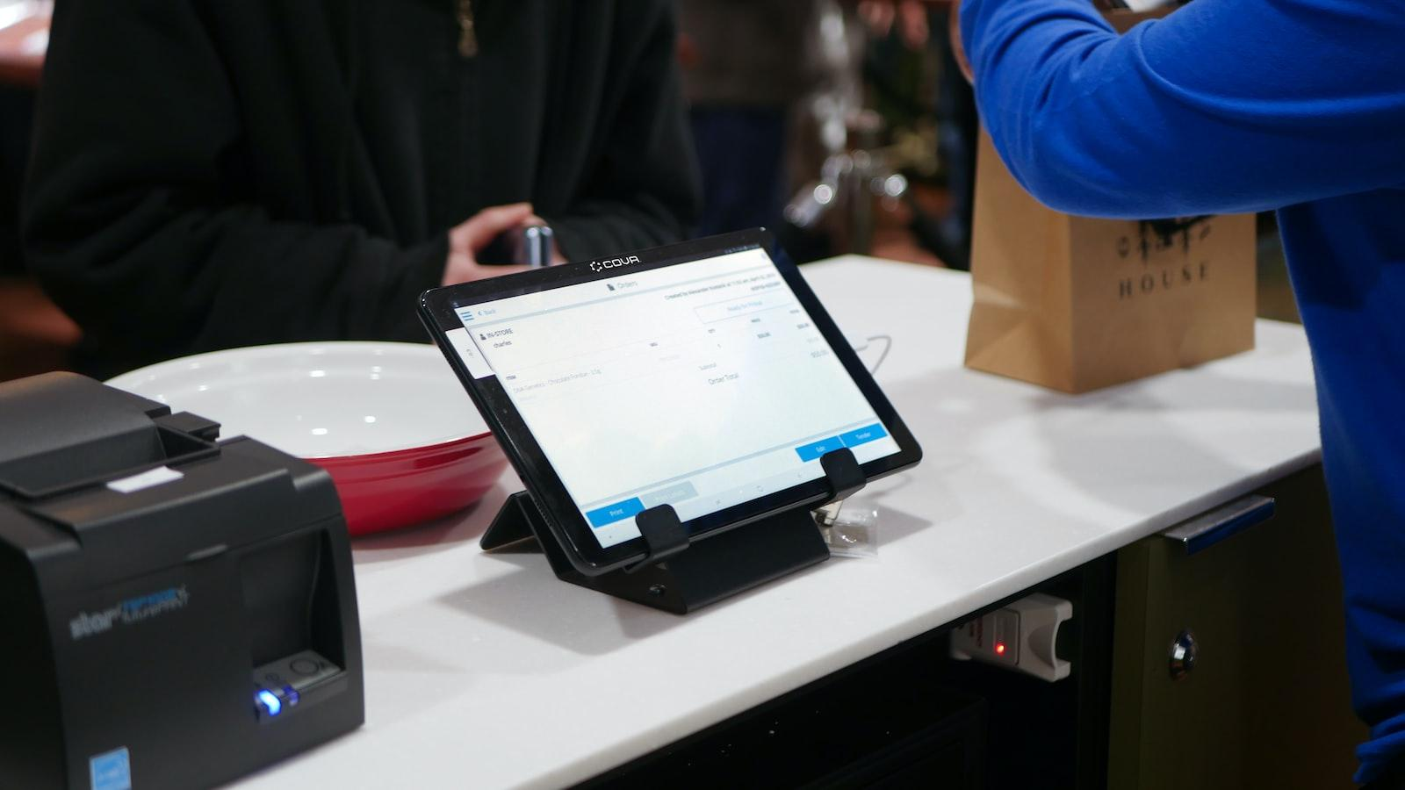
E-OPD
Online Consultations and Appointments
E-OPD is a type of telemedicine that provides online consultations and appointments
It can be used in E-Clinics to provide remote healthcare services
E-OPD is particularly useful for patients who need to consult with a healthcare professional but cannot travel to a physical clinic
‎
‎Photo by Unsplash
Notes:
Define E-OPD and how it can be used in E-Clinics to provide online consultations and appointments.

Slide 5
Telemedicine
Remote Healthcare Services
Telemedicine is the use of technology to provide remote healthcare services
It can be used in E-OPD to provide remote consultations and appointments
Telemedicine is particularly useful for patients who live in remote areas or have mobility issues
‎
Notes:
Discuss the role of telemedicine in E-OPD and how it can be used to provide remote healthcare services.

Slide 6

Patient Management
Managing Patient Records and Appointments
E-OPD can be used to manage patient records and appointments
Electronic health records can be used to store patient information securely
E-OPD can help to improve patient management and reduce administrative burden
‎
‎Photo by Unsplash
Notes:
Explain how E-OPD can be used to manage patient records and appointments, including the benefits of using electronic health records.

Slide 7
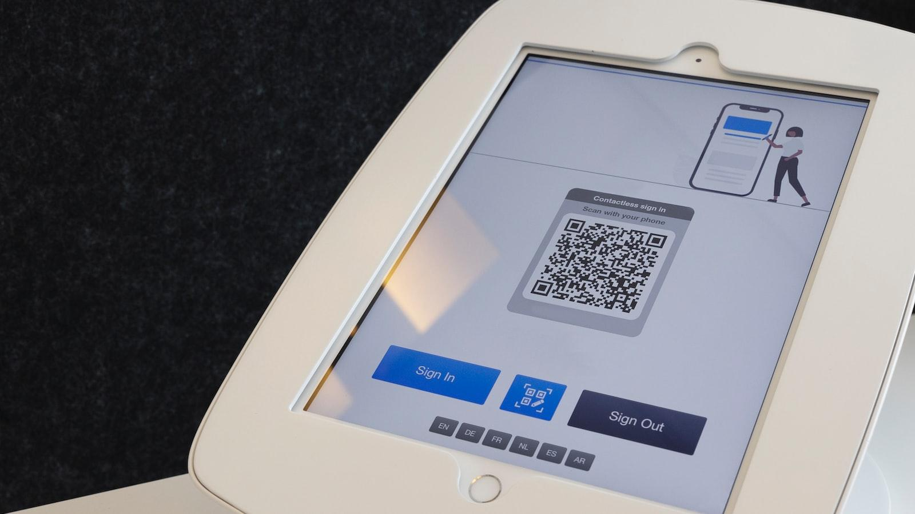
Technology
Hardware and Software Requirements
Implementing E-OPD in E-Clinics requires specific hardware and software
Hardware requirements include computers, tablets, and smartphones
Software requirements include E-OPD software and electronic health record software
‎
‎Photo by Unsplash
Notes:
Discuss the technology required for implementing E-OPD in E-Clinics, including hardware and software requirements.

Slide 8

Security and Privacy
Protecting Patient Data
Security and privacy are critical considerations when implementing E-OPD in E-Clinics
Best practices for ensuring patient data is protected include using encryption, implementing access controls, and conducting regular security audits
Healthcare organizations must comply with relevant regulations and standards, such as HIPAA and GDPR
‎
‎Photo by Unsplash
Notes:
Highlight the importance of security and privacy in E-OPD and discuss best practices for ensuring patient data is protected.

Slide 9
Training
Using E-OPD and E-Clinics
Training is essential for community paramedics and healthcare professionals in using E-OPD and E-Clinics
Training should cover the use of E-OPD software, electronic health records, and telemedicine technology
Ongoing training and support is necessary to ensure that healthcare professionals are comfortable using E-OPD and E-Clinics
‎
Notes:
Discuss the importance of training for community paramedics and healthcare professionals in using E-OPD and E-Clinics.

Slide 10

Challenges
Implementing E-OPD in E-Clinics
Implementing E-OPD in E-Clinics can be challenging due to infrastructure and connectivity issues
Healthcare organizations must ensure that they have the necessary hardware and software to support E-OPD
Healthcare organizations must also ensure that they have a reliable internet connection to support E-OPD
‎
‎Photo by Unsplash
Notes:
Examine the challenges of implementing E-OPD in E-Clinics, including infrastructure and connectivity issues.

Slide 11
Case Studies
Successful Implementation of E-OPD
Case studies demonstrate successful implementation of E-OPD in E-Clinics run by community paramedics
These case studies highlight the benefits of using E-OPD, including improved access to healthcare and reduced costs
Successful implementation of E-OPD requires careful planning, training, and ongoing support
‎
Notes:
Present case studies demonstrating successful implementation of E-OPD in E-Clinics run by community paramedics.

Slide 12
Conclusion
Key Takeaways and Recommendations
E-OPD for E-Clinics run by community paramedics is a powerful tool for improving access to healthcare in remote areas
Implementing E-OPD requires careful planning, training, and ongoing support
Healthcare organizations must ensure that they have the necessary hardware and software to support E-OPD, and that they comply with relevant regulations and standards
Notes:
Summarize the key takeaways from the presentation and offer recommendations for implementing E-OPD in E-Clinics run by community paramedics.

